Slide 1
Unsymmetrical Fault Analysis

Slide 2
INTRODUCTION
Unsymmetrical faults create unbalanced voltage and current phasors. And, Analyzing unsymmetrical faults via KCL and KVL are very cumbersome.
Unsymmetrical faults involve only one or two phases. In unsymmetrical faults the three phase lines become unbalanced.
The calculation of unsymmetrical fault can be done by method of symmetrical components(Fortescue theorem) to determine current and voltage on occurrence of unsymmetrical fault.
unsymmetrical faults considered for analysis include the following (in the order of their severity):
i) Line–to–Ground (L-G) Fault
ii) Line–to–Line (L-L) Fault
iii) Double Line–to–Ground (L-L-G)Fault

Slide 3
Symmetrical components (Fortesque's Theorem )
Fortescue described how arbitrary unbalanced 3-phase voltages (or currents) could be transformed into 3 sets of balanced 3-phase components
Statement: Any unbalanced system of 3 phase current or voltage may be regarded as being composed of three separate sets of balanced vector. These symmetrical components are called positive sequence, negative sequence and zero sequence.
Each component is analyzed separately. Analysis of each component is easy as it is balanced set of phasors.
The output for each component can be subsequently added to obtain final values. Final values will be unbalanced.
Individual component responses can be added only when N/W for each sequence component are perfectly decoupled i.e. the result of one is independent of the other.
Fortunately in power system, positive sequence N/W, negative sequence N/W and zero sequence N/W are not mutually coupled. This makes symmetrical component decomposition for analyzing unbalanced fault an effective tool

Slide 4
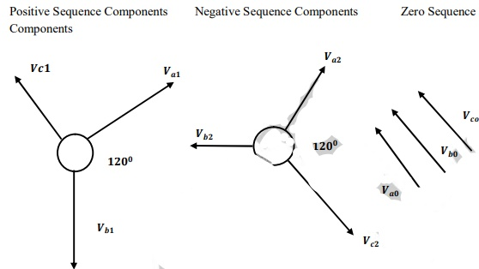
Three sets of balanced phasors which are the symmetrical components of three unbalanced phasors. Shown in below figures.
According to fortesque theorem, Since the three un balanced vectors V_{a} V_{b} and V_{c} can be resolved into three sets of balanced vectors, the vector V_{a} is equal to the sum of the positive sequence component V_{a 1} of phase a, the negative sequence component V_{a2} of phase a, and zero sequence component V_{ao} of phase a. and, similarly for phase b and phase c
V_{a} = V_{ao} + V_{a1} + V_{a2}
V_{b} = V_{bo} + V_{b1} + V_{b2}
V_{c} = V_{co} + V_{c1} + V_{c2}
3 unbalanced vectors (Va, Vb, Vc )resolved into a total of 9 vectors, i.e, Va1,Va2 Va0 and Vb1, Vb2, Vb0 and Vc1, Vc2, Vc0. Out of these, only 3 are unknown. So, only three components are linearly independent.

Slide 5
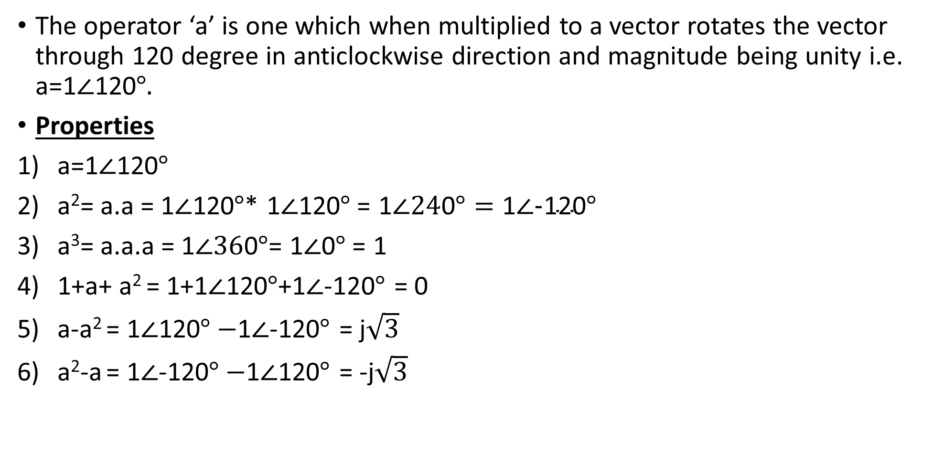
Sequence operator ‘a’
The operator ‘a’ is one which when multiplied to a vector rotates the vector through 120 degree in anticlockwise direction and magnitude being unity i.e. a=1$∠$120$°.$
Properties
a=1$∠$120$°$
a²= a.a = 1$∠$120$°$* 1$∠$120$°$= 1$∠24$0$°=\text{1}∠\text{−}\text{120}°$
a³= a.a.a = 1$∠36$0$°$= 1$∠$0$°$= 1
1+a+ a² = 1+1$∠$120$°$+1$∠$-120$°$ = 0
a-a² = 1$∠$120$°−$1$∠$-120$°$ = j$\sqrt{3}$
a²-a = 1$∠$-120$°−$1$∠$120$°$ = -j$\sqrt{3}$

Slide 6
Unbalanced voltage and current in terms of symmetrical components
Va, Vb and Vc are the unsymmetrical three phase voltage. Then, in terms of symmetrical components it can be written as,
V_{a} = V_{ao} + V_{a1} + V_{a2}
V_{b} = V_{bo} + V_{b1} + V_{b2}
V_{c} = V_{co} + V_{c1} + V_{c2}
Using phase operators, it can be written as
V_{a} = V_{ao} + V_{a1} + V_{a2}
V_{b} = V_{bo} + V_{b1} + V_{b2}
= V_{ao} + a²V_{a1} + aV_{a2}
V_{c} = V_{co} + V_{c1} + V_{c2}
= V_{ao} + aV_{a1} + a²V_{a2}

Slide 7

In matrix form,
$\left[\begin{matrix}Va \\ \begin{aligned}Vb \\ Vc\end{aligned}\end{matrix}\right]=\left[\begin{matrix}1 & 1 & 1 \\ 1 & a2 & a \\ 1 & a & a2\end{matrix}\right] \left[\begin{matrix}Va0 \\ Va1 \\ Va2\end{matrix}\right]$
[V]^{abc} = [A] [V]⁰¹²
Similarly,
$\left[\begin{matrix}Va0 \\ Va1 \\ Va2\end{matrix}\right]$ = $\frac{1}{3}\left[\begin{matrix}1 & 1 & 1 \\ 1 & a & a2 \\ 1 & a2 & a\end{matrix}\right]$ $\left[\begin{matrix}Va \\ \begin{aligned}Vb \\ Vc\end{aligned}\end{matrix}\right]$
[V]⁰¹² = [A]⁻¹ [V]^{abc}
Similarly, it holds true for current also

